Slide 1
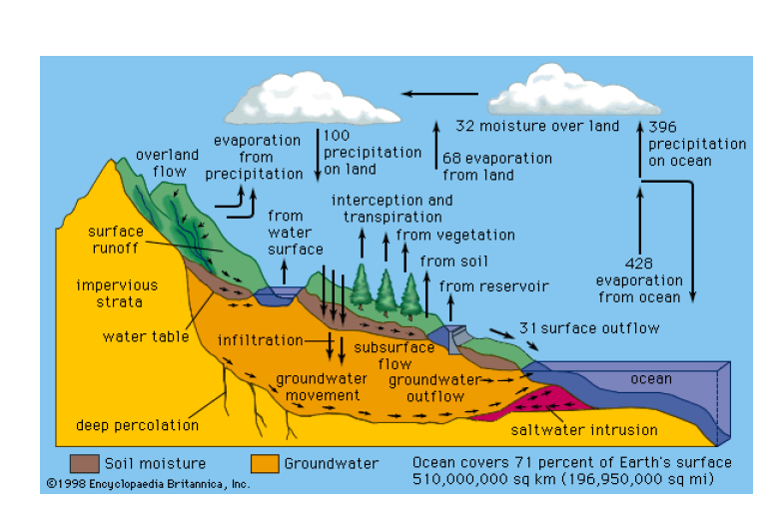
Unit-I
Water & It’s Treatment

Slide 2
Types of impurities in water
Organic Impurities: Organic impurities are decaying plant and animal matter. These impurities give water an unpleasant taste and odor.
Inorganic Impurities: These impurities include dissolved minerals, heavy metals ,pesticides, industrial pollutants, and pharmaceuticals.
Physical Impurities: These impurities include sediment, sand, rust, and debris, which affect water clarity and taste.
Total Dissolved Solids (TDS):TDS refers to the total concentration of dissolved minerals and salts in water. High TDS levels can lead to water that tastes salty or bitter.
Biological Impurities: Biological impurities include bacteria, viruses, and parasites. Consuming such water can lead to waterborne diseases.

Slide 3
Difference between hard water and soft water
Hard Water | Soft Water
Hard water does not lather with soap but instead forms a precipitate. | Soft water lather with soap.
Hard water doesn't form lather or foam with soap. | Soft water forms lather and foam with soap.
Soap is not effective against hard water. | Soap is effective against soft water.
Hard water has a characteristic taste and isn’t suitable for heavy machinery, boilers, and other appliances. | Soft water is known to have a salty taste and is widely suitable for machinery, boilers, etc.
Hard water is rich in minerals. Hence it mainly contains minerals such as magnesium and calcium. | Soft water is not rich in minerals. It mainly contains sodium ions.
Example: Water found in wells, groundwater | Example: rainwater

Slide 4
The hardness of water
The total amount of dissolved calcium and magnesium salts present in the water is called hardness water.
Causes of hardness of water:
The presence of bicarbonates, chlorides, and the sulphates of calcium and magnesium in water causes the hardness of water.
Cations Ca²⁺ and Mg²⁺ present in hard water react with soap (sodium stearate) to form insoluble precipitates (calcium or magnesium stearate).
Lather will not be produced until all the calcium and magnesium ions are precipitated. Thus, it hinders the cleansing action of soap.
This also results in the wastage of a quantity of soap.
2C₁₇H₃₅COONa + CaCl₂ → (C₁₇H₃₅COO)₂Ca ↓ +2NaCl
Calcium Stearate
2C₁₇H₃₅COONa + MgSO₄→(C₁₇H₃₅COO)₂Mg↓ +Na₂SO₄
Magnesium Stearate

Slide 5
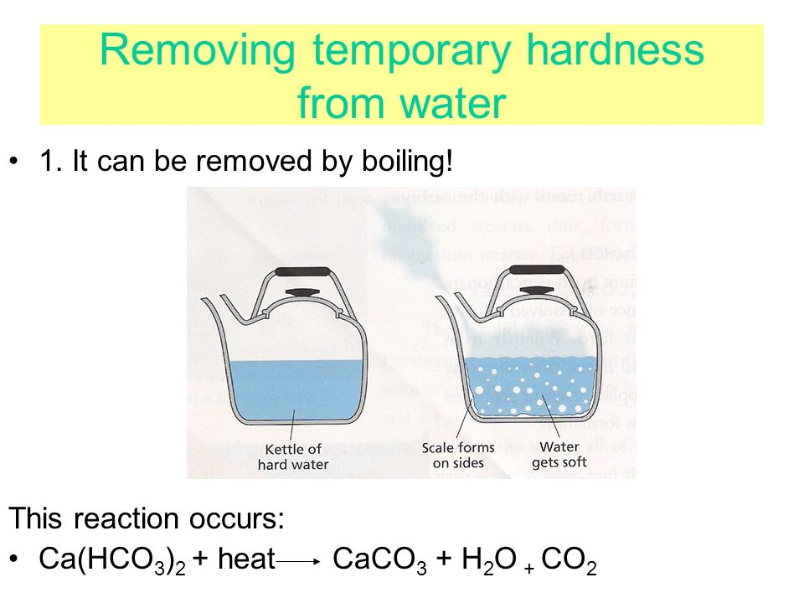
Types of Hardness
Temporary hardness:
It is caused by the presence of dissolved bicarbonates of calcium and magnesium and carbonates of Iron.
Temporary hardness is easily removed by boiling, on boiling bicarbonates are decomposed into insoluble carbonates or hydroxides.
Ca (HCO₃)₂ → CaCO₃↓ + H₂O + CO₂↑
Mg (HCO₃)₂ → Mg (OH) ₂ ↓+ 2CO₂↑
It is also known as carbonate hardness.

Slide 6
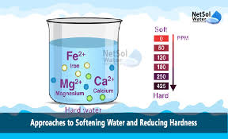
Permanent hardness
It is caused by the presence of dissolved chlorides, and sulphates of the calcium and magnesium and iron.
The dissolved salts are CaCl₂, MgCl₂, CaSO₄, MgSO₄, FeSO₄, Al₂(SO₄)₃ etc.
Unlike temporary hardness, permanent hardness is not destroyed on boiling.
It is also known as non carbonate hardness.

Slide 7
Degree of Hardness
The hardness of water is expressed in terms of calcium carbonate equivalents.
The weights of different salts that causing hardness are converted to weight equivalent to that of calcium carbonate.
The reason for choosing CaCO₃ as standard for reporting hardness is ease in calculations as its molecular weight is exactly 100 and is insoluble in water.
Hardness causing salt and molecular weight
Ca(HCO₃)₂ = 162
Mg(HCO₃)₂ = 146
CaSO₄ = 136
MgSO₄ =120
CaCl₂ = 110
MgCl₂ = 95
CaCO₃ =100

Slide 8
Units for Hardness
Parts per million(ppm):-The number of parts by weight of CaCO₃ present per million (10⁶) parts by weight of water.
1ppm = 1 part of CaCO₃ equivalents in 10⁶ parts of water.
Degree Clarke(ºCl):- Parts of CaCO₃ equivalents of hardness per 70.000 parts of water.
1ºCl = 1 part of CaCO₃ per 70,000 parts of water.
Degree French(⁰Fr):- The parts of CaCO₃ equivalents of hardness per 10⁵ parts of water.
1ºFr = 1 part of CaCO₃ per 10⁵ parts of water.
Milligram per litre
1 mg/lit = 1 mg of CaCO3 present in 1 lit of water
Relationship between units:
1 mg/lit = 1ppm = 0.07ºCl = 0.1ºFr

Slide 9
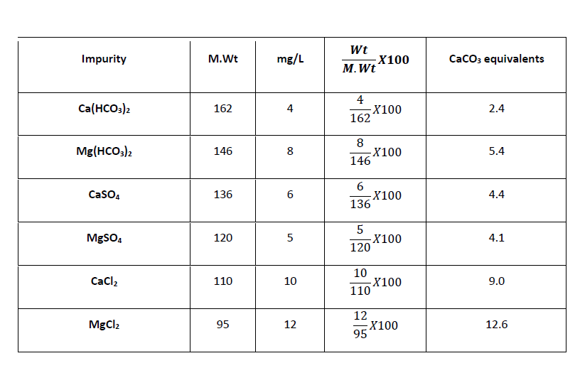
A water sample on analysis is found to contain the following impurities. Calculate the temporary, permanent and total hardness of water in mg, ppm, ºFr and ºCl.
Impurity | Ca(HCO₃)₂ | Mg(HCO₃) | CaSO₄ | MgSO₄ | CaCl₂ | MgCl₂
weight | 4 | 8 | 6 | 5 | 10 | 12
Molecular weight | 162 | 146 | 136 | 120 | 110 | 95
Solution
Ca (HCO₃)₂ and Mg (HCO₃)₂ cause temporary hardness
2.4 + 5.4=7.8 mg or ppm
7.8X0.07 = 0.546 ºCl
7.8 x 0.1 = 0.78 ºFr
CaSO₄, MgSO₄, CaCl₂, and MgCl2, cause permanent hardness
4.4 + 4.1 + 9.0 + 12.6 = 30.1 mg (or) ppm
30.1 X 0.07 = 2.1 ºCl
30.1 X 0.1 = 3.01 ºFr
Total hardness = Temporary hardness + Permanent hardness
7.8 + 30.1 = 37.9 mg (or) ppm
37.9X 0.07 =2.65 ºCl
37.9 X 0.1 = 3.79 ºFr

Slide 10
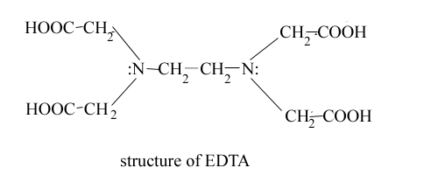
ESTIMATION OF HARDNESS OF WATER BY COMPLEXOMETRIC METHOD
PRINCIPLE:
The capacity of water to precipitate soap (prevent lather) is the hardness. It is caused by dissolved calcium and magnesium salts. Bicarbonates cause temporary hardness and chlorides and sulphates permanent hardness.
Ethylene diamine tetra acetic acid (EDTA) is a complexing agent, hexa-dentate ligand and forms complexes with Ca²⁺, Mg²⁺ ions. Hence the titration is complexometric titration. Eriochrome Black-T is the indicator and is blue in colour in Free State.

Slide 11
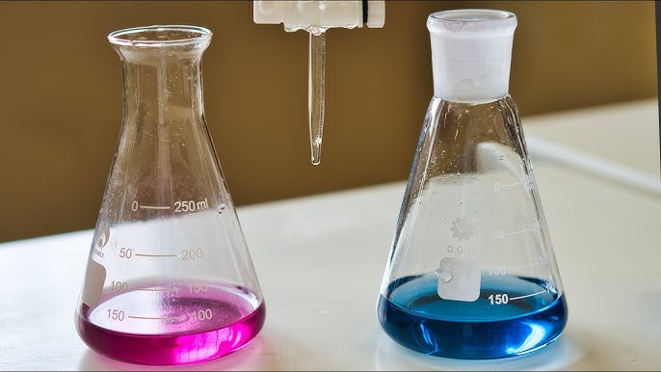
When EBT is added to the hard water at p^{H} = 10, it gives wine-red colored unstable complexes with Ca²⁺ and Mg²⁺ ions. The solution turns blue when this mixture is titrated against EDTA solution.

Slide 12
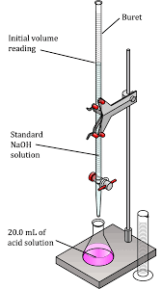
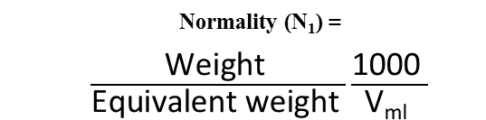
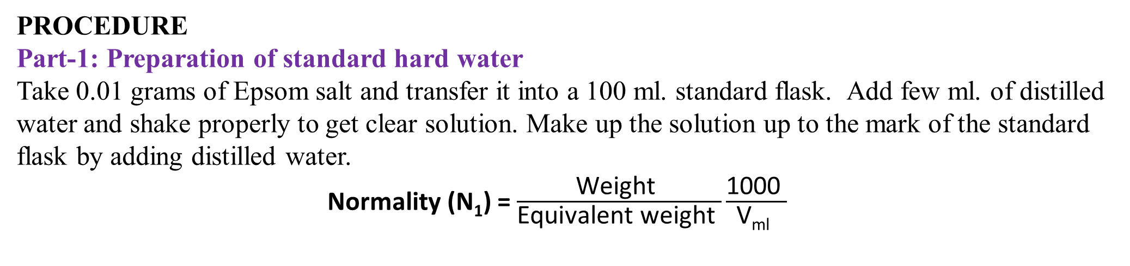
PROCEDURE
Part-1: Preparation of standard hard water
Take 0.01 grams of Epsom salt and transfer it into a 100 ml. standard flask. Add few ml. of distilled water and shake properly to get clear solution. Make up the solution up to the mark of the standard flask by adding distilled water.
Normality (N₁) = $\frac{\text{Weight} }{\text{Equivalent} \text{weight} }\frac{\text{1000} }{\text{V}\text{ml} }$
Part-2
Standardization of EDTA
Pipette out 10ml. of Standard hard water into a conical flask. Add 5ml (approx.) of buffer solution and 2 to 3 drops of Eriochrome black-T indicator. The solution attains wine-red colour. Titrate the contents of the conical flask against the EDTA solution until the colour changes to blue. Note the burette reading and repeat the titration to get concurrent values.
N₁V₁ (Standard hard water) = N₂V₂ (EDTA)
Normality of standard hard water (N₁) =
Volume of standard hard water (V₁) = 10 ml.
Normality of EDTA (N₂) =?
Volume of EDTA used in 2nd step (V₂) =?
Normality (N₁) = $\frac{\text{Weight} }{\text{Equivalent} \text{weight} }\frac{\text{1000} }{\text{V}\text{ml} }$

Slide 13
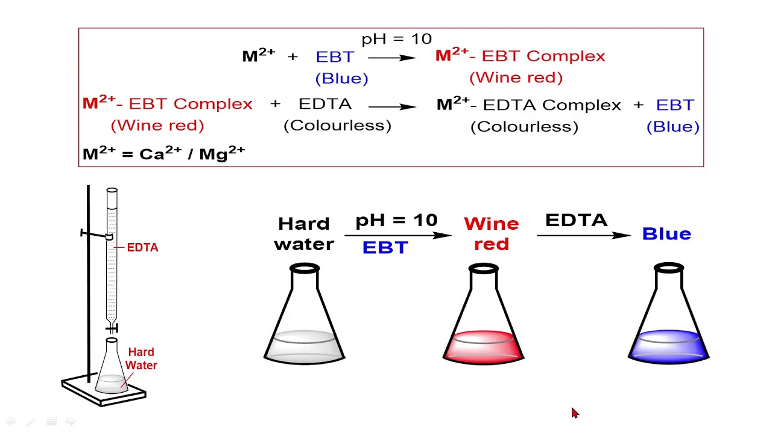
Part-3
Determination of total hardness of test sample of water
Pipette out 10ml. of test water sample into the conical flask. Add 5ml (approx) of buffer and 2 to 3 drops of Eriochrome Black-T indicator. The solution attains wine-red colour. Titrate the contents of the conical flask against EDTA solution till the colour changes from wine-red to blue. Note the burette reading and repeat the titration to get concurrent values.
N₂V₂ (EDTA) = N₃V₃ (Test water sample)
Normality of test water sample (N₃) =
Volume of test water sample (V₃) = 10 ml.
Normality of EDTA (N₂) =?
Volume of EDTA used in 3rd step (V₂) =?
The total hardness of the test sample of water is calculated as follows
Total hardness = N₃ × 50 × 1000 = ----- mg/lit or ppm.
The total hardness of water is ------------ mg/lit or ppm.

Slide 14
Part-4
Determination of Permanent hardness of test sample of water
Take 50ml of water in beaker , boil for 10 minutes and filter the water. Pipette out 10ml. of boiled test water sample into the conical flask. Add 5ml (approx) of buffer and 2 to 3 drops of Eriochrome Black-T indicator. The solution attains wine-red colour. Titrate the contents of the conical flask against EDTA solution till the colour changes from wine-red to blue. Note the burette reading and repeat the titration to get concurrent values.
N₂V₂ (EDTA) = N₄V₄ (boiled Test water sample)
Normality of boiled test water sample (N₄) =
Volume of boiled test water sample (V₄) = 10 ml.
Normality of EDTA (N₂) =?
Volume of EDTA used in 4th step (V₂) =?
The permanent hardness of the test sample of water is calculated as follows
Permanent hardness = N₄ × 50 × 1000 = ----- mg/lit or ppm.
The total hardness = Permanent hardness + Temporary hardness.
Temporary hardness = The total hardness - Permanent hardness

Slide 15


1.0 gm of Epsom salt was dissolved in 100 ml of distilled water. 50 ml of this solution required 45 ml of EDTA solution for titration. 50 ml of test hard water sample required 28 ml of EDTA and after boiling and filtering required 15 ml of EDTA solution. Calculate the total hardness, permanent hardness and temporary hardness of water.
Normality of St.HW (N₁) =
=
N₁V₁ (St. HW) = N₂V₂ (EDTA) = 0.08 × 50 = N₂ × 45, N₂ = 0.088N
N₂V₂ (EDTA) = N₃V₃ (TWS) = 0.088 × 28 = N₃ × 50, N₃ = 0.049N
Total hardness = N₃ × 50 × 1000 = 0.049 × 50 × 1000 = 2450 mg/lit (or) ppm.
N₂V₂ (EDTA) = N₄V₄ (boiled TWS) = 0.088 × 15 = N₄ × 50 = 0.026N
Permanent hardness = N₄ × 50 × 1000 = 0.026 × 50 × 1000= 1300 mg/lit (or) ppm.
The total hardness = Permanent hardness + Temporary hardness.
Temporary hardness = The total hardness - Permanent hardness = 2450- 1300 = 1150 mg/ lit (or) ppm

Slide 16
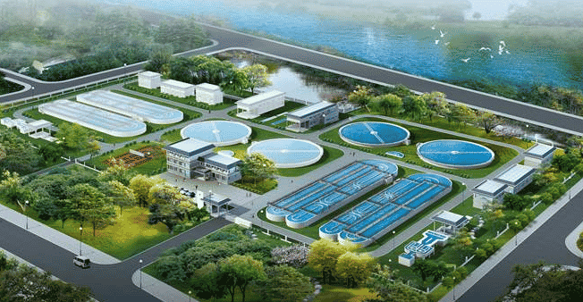
Specifications of Potable or Domestic Water (WHO)
The water supplied by municipality should be fit for human consumption.
It should satisfy the following requirements:
It should be colorless, odourless, and pleasant to taste.
Turbidity should not exceed 10 ppm.
TDS should not exceed 500 ppm.
It should not be very alkaline (pH 8.0).
It should be free from dissolved gases.(H₂S,CO₂)
It should be free from objectionable minerals such as Pb, As, Cs, Mn.
It should be free from pathogenic organism.

Slide 17
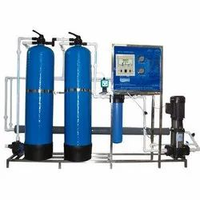
Portable Water Treatment
Treatment of water for drinking purposes mainly includes the removal of suspended impurities, colloidal impurities and harmful pathogenic bacteria.
The following stages are involved in purification
1. Screening
2. Sedimentation
3. Coagulation
4. Filtration
5. Disinfection
As required, other steps will be added, depending on the chemistry of the treated water.

Slide 18
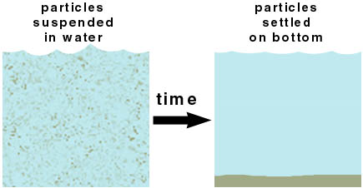
Screening
Screens remove large floating or suspended solids in the process of inflow. Materials like leaves, paper, twigs, and other debris are removed so as to avoid equipment or plant damage.
Aeration: The water is then subjected to aeration(reacting with air) which helps in exchange of gases between water and air, increases the oxygen content and removes the impurities like iron, manganese and dissolved gases like H₂S, CO₂ and NH₃
Sedimentation : The process of removing big sized suspended solid particles from water is called as plain sedimentation. In this process, water is stored in big tanks for several hours. 70% of solid particles settle down due to force of gravity.

Slide 19
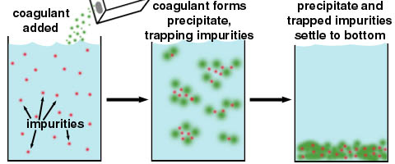
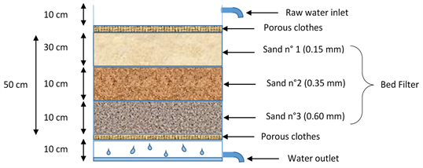
Coagulation : This is the process of removing fine suspended and colloidal impurities by adding coagulants like potassium alum (K₂SO₄Al₂(SO₄)₃ 24H₂O), Ferrous sulphate (FeSO₄), Sodium aluminate (NaAlO₂).
When coagulant is added to water, floc formation takes place due to hydroxide formation which can gather tiny particles together to form bigger particles and settle down quickly.
Filtration: The process of passing a liquid containing suspended impurities through a suitable porous material so as to effectively removed suspended impurities and some microorganisms is called filtration.
It is a mechanical process. When water flows through a filter bed, many suspended particles are unable to pass through the gaps and settle in the bed.

Slide 20
Disinfection or sterilization: The process of killing pathogenic bacteria and other microorganisms is called disinfection or sterilization. The chemicals used for killing bacteria are called disinfectants.
Chlorination: The process of adding chlorine to water is called chlorination. Chlorine gas is a very good disinfectant, which can be bubbled in the water.
In this process calculated amount of chlorine gas is passed in order to destroy the pathogenic bacteria is called chlorination. Chlorine is also reacts with water and generates hypochlorous acid and nascent oxygen, which acts a powerful oxidizing agent and kills the bacteria
Cl₂ + H₂O → HCl + HOCl
Bacteria + HOCl → killed bacteria
Advantages:
Storage requires less space, Effective and economical
Produce no salts, Ideal disinfectant
Disadvantages:
Excess of chlorine causes unpleasant taste and odour.
More effective at below p^{H} 6.5 and less effective at higher p^{H} values.

Slide 21
Break Point Chlorination (or) Free Residual Chlorination
Chlorination is one of the most common methods used in water treatment, primarily for disinfection.
During the process, Chlorine (Cl₂), Hypochlorous acid (HOCl), or Sodium hypochlorite (NaOCl) is added to water.
Apart from killing microorganisms, it can also help in removing or controlling some chemical impurities.
Microbial Contaminants: Bacteria (E. coli, Salmonella, Vibrio cholera), Viruses (Hepatitis A, enteroviruses), Protozoa (Giardia and Cryptosporidium) and other pathogens.
Organic Impurities: Organic matter (like phenols, hydrogen sulfide, and certain amines).
Inorganic Impurities: Iron (Fe²⁺) , Manganese (Mn²⁺), Hydrogen sulfide (H₂S), Nitrite (NO₂⁻).
Limitations: Chlorination does not remove dissolved salts (hardness, fluorides, nitrates, chlorides, sulfates, etc.). It may produce disinfection.

Slide 22
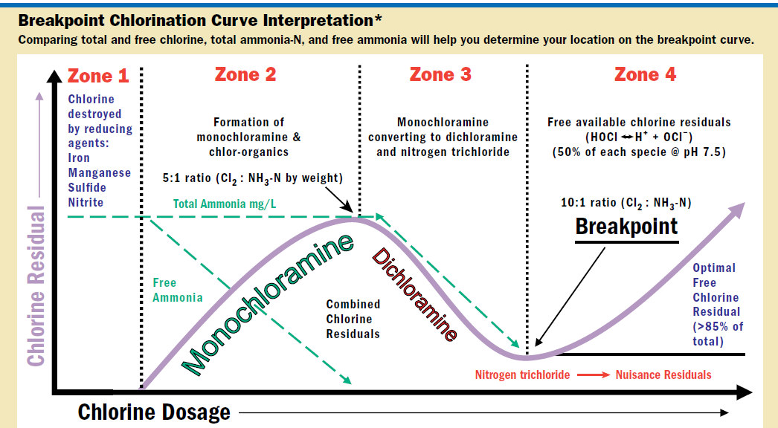

Slide 23
The breakpoint chlorination curve explains what happens when chlorine is added to water containing ammonia and other reducing agents.
It is widely used in water treatment to understand chlorine demand, chloramine formation, and the point where free chlorine becomes available for effective disinfection.
Zone-1 (Chlorine Demand): Chlorine is consumed by reducing agents such as iron, manganese, sulfide, and nitrite. No chlorine residual remains in the water. Chlorine is 'used up' neutralizing impurities.
Zone-2 (Formation of Chloramines): Chlorine reacts with ammonia to form monochloramine. Some chlorinated organic compounds may also form. Combined chlorine residuals (chloramines) appear.
Zone-3 (Chloramine Conversion & Nuisance Residuals): Additional chlorine converts monochloramine into dichloramine and nitrogen trichloride. Combined chlorine residuals start to decrease. These are considered nuisance residuals as they cause taste and odor problems.
Zone-4 (Breakpoint Chlorination): At the breakpoint, all ammonia and chloramines are oxidized and destroyed. Beyond this point, free chlorine residuals (HOCl and OCl⁻) appear. Free chlorine is the most effective disinfectant.

Slide 24
Breakpoint chlorination is the process of adding sufficient free chlorine to water to oxidize all reducing compounds and ammonia, thereby satisfying the water's chlorine demand and producing a free residual chlorine that acts as a potent disinfectant.
Impurity | Effect of Chlorination
1. Organic impurities (phenols, algae, odor compounds) | Oxidized, reducing taste and odor problems.
2. Iron (Fe²⁺) | Oxidized to Fe³⁺ and precipitated as ferric hydroxide.
3. Manganese (Mn²⁺) | Oxidized to MnO₂ precipitate.
4. Hydrogen sulfide (H₂S) | Oxidized to elemental sulfur or sulfate, removing foul odor.
5. Nitrites (NO₂⁻) | Oxidized to nitrates (NO₃⁻).
6. Bacteria, Viruses, Protozoa | Destroyed or inactivated by chlorine (disinfection).

Slide 25
Defluoridation of Potable Water by Nalgonda Technique
The Nalgonda Technique is a simple and widely used method for defluoridation of drinking (potable) water, developed by the National Environmental Engineering Research Institute (NEERI), Nagpur.
It is particularly suitable for rural and semi-urban areas in India where groundwater has high fluoride content.
PRINCIPLE: The technique works on the principle of chemical precipitation, adsorption, and coagulation–flocculation. Fluoride ions are removed by adding chemicals such as alum (aluminum sulfate), lime, and bleaching powder, which form insoluble complexes and settle along with suspended impurities.
Chemicals Used:
1. Alum (Al₂(SO₄)₃·18H₂O) – acts as coagulant and precipitates fluoride.
2. Lime (Ca(OH)₂) – aids in floc. formation and pH adjustment.
3. Bleaching powder (Ca(OCl)₂) – disinfects the treated water.

Slide 26
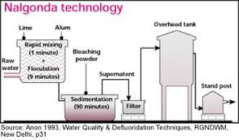
PROCESS STEPS:
Chemical dosing: Add the required amounts of alum, lime, and bleaching powder to the water.
Rapid mixing – Stir the water vigorously for a short time so the chemicals disperse uniformly.
Flocculation – Slow stirring helps in the formation of floc. which trap fluoride ions and suspended impurities.
Sedimentation – Allow water to stand undisturbed for a 1 hour, so the floc. settle at the bottom.
Filtration: Clear water is decanted or filtered to remove settled sludge.
Storage & supply: Defluoridated, and disinfected water is stored for drinking purposes.
Advantages
Simple, low-cost, and easy to operate.
Can be applied both at household & community level.
Removes not only fluoride but also turbidity, color, and bacteria.
Limitations
Requires accurate chemical dosing
Generates sludge that needs proper disposal.
May slightly change taste of water.

Slide 27
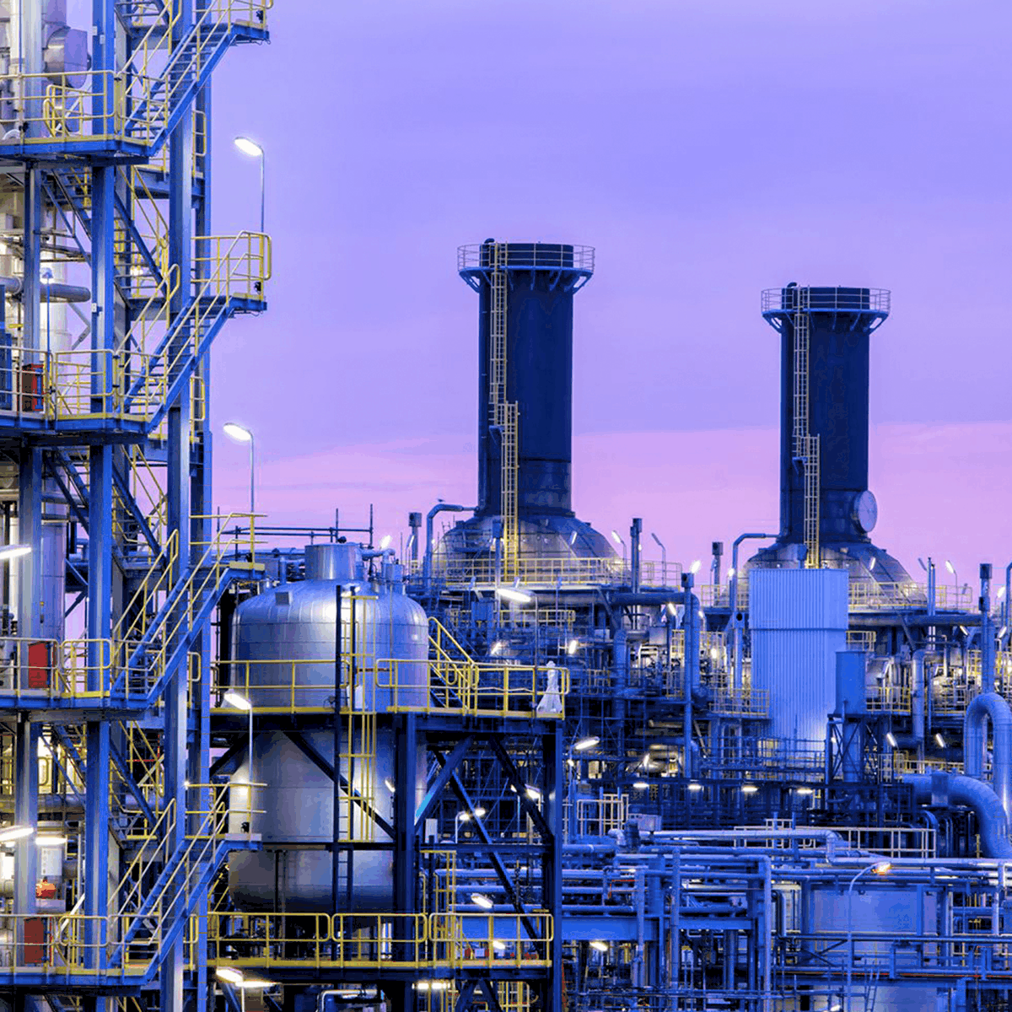
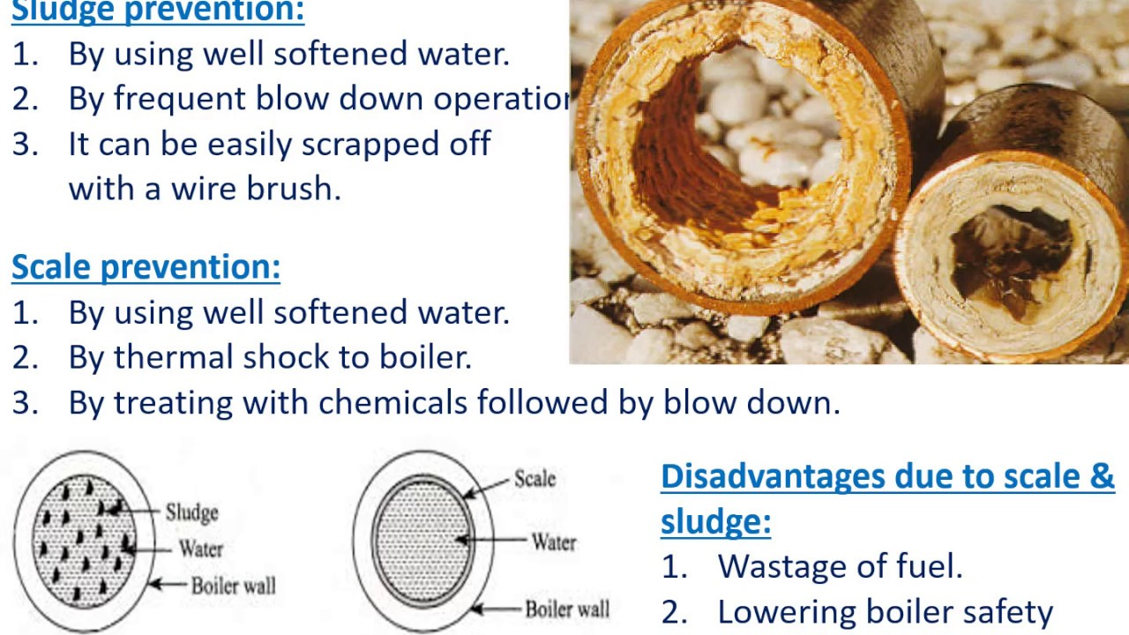
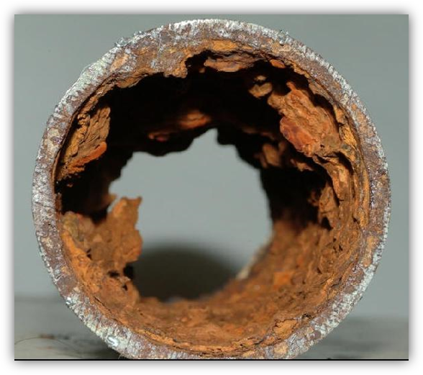
Boiler troubles
Boilers are employed in industries for generation of steam.
When raw water is directly feed into the boilers various physical changes and chemical reactions are induced in the boiler with the action of the heat.
The ultimate result being the problem such as
Caustic embrittlement and
Sludge and Scale formation.

Slide 28
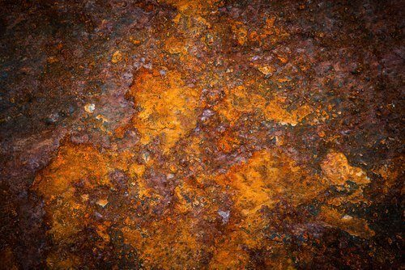
Caustic Embrittlement
This is phenomenon during which the boiler material becomes brittle due to the accumulation of caustic substances.
During softening by lime-soda process, it is likely that some residual Na₂CO₃ is still present in the softened water.
In high pressure boilers Na₂CO₃ decomposes to give sodium hydroxide and CO₂, and sodium hydroxide thus produced makes the boiler water “caustic”.
Na₂CO₃ + H₂O 2NaOH + CO₂
This caustic water flows into the minute hair-cracks, present in the inner side of boiler, by capillary action.
On evaporation of water the dissolved caustic soda concentration increases progressively which attacks the surrounding area, thereby dissolving iron of boiler as Sodium ferrate (Na₂FeO₂).
3 Na₂FeO₂ + 4 H₂O 6NaOH + Fe₃O₄ + H₂

Slide 29
Further dissolution of iron takes place because of the precipitation of Fe₃O₄, and the regeneration of NaOH.
This causes embrittlement of boiler walls more particularly at stressed parts like bends, joints, rivets, etc., causing even failure of the boiler.
Caustic Embrittlement can be prevented:
By using sodium phosphate as softening reagent instead of sodium carbonate in external treatment.
By adding tannin or lignin to boiler water which blocks the hair-cracks in the boiler walls.
By adding sodium sulphate to boiler water. Na₂SO₄ also blocks hair-cracks.

Slide 30
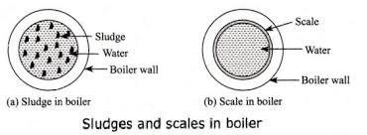
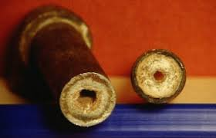
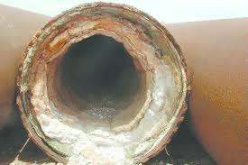
2. Sludge & Scale formation
In boilers, water evaporates continuously and concentration of dissolved salts increases.
When it reaches saturation point they will be precipitated on the inner walls of the boilers.
If the precipitation takes place in the form of loose and slimy, it is called sludge.
If the precipitation takes place in the form of hard, adhering on the inner walls of the boilers, it is called scale.

Slide 31
Difference between Sludges and Scales
Sludges | Scales
Sludges are soft loose and slimy precipitate. They are non-adherent deposits and can be easily removed. Formed by substances like CaCl₂ , MgCl₂ ,MgSO₄, MgCO₃ etc. Formed at comparatively colder portion of the boiler. They decrease the efficiency of boiler but are less dangerous. Can be removed by blow-down operation. | Scales are hard deposits. They sticks very firmly to the inner surface of boiler and are very difficult to remove. Formed by substance like CaSO₄, Mg(OH)₂ etc. Formed generally at heated portions of the boiler. Decrease the efficiency of boiler and chances of explosions are also there. Cannot be removed by blow-down operation.

Slide 32
SLUDGE
Sludges are soft, loose, and slimy deposits that settle at the bottom of the boiler.
It is formed at colder portions of the boilers.
It is formed by substances, which have greater solubility in hot water than cold water(MgCO₃,MgCl₂, MgSO₄, CaCl₂).
It can easily scrapped off with a wire brush.
Disadvantages:
Reduce boiler efficiency
Cause blockages in valves and pipelines
Promote corrosion
Prevention of Sludge Formation:
Blow-down operation (discharge of water from boiler bottom)
Chemical treatment
External water treatment (lime-soda, zeolite, ion exchange, demineralization)

Slide 33
SCALES
Scales are hard, adherent, and crystalline deposits that stick firmly to the boiler walls. Scales may be formed inside the boiler due to:
A).Decomposition of Ca (HCO₃)₂:-In low pressure boilers CaCO3 causes scale formation, but high pressure boilers CaCO3 is soluble
Ca (HCO₃)₂ → CaCO₃↓ +H₂O +CO₂↑
CaCO₃ + H₂O → Ca(OH)₂ + CO₂↑
B). Deposits of CaSO₄:- The solubility of CaSO₄ decreases with increasing the temperature. So it is soluble in cold water and insoluble in hot water. Hence it get precipitated in hotter region.
C). Hydrolysis of MgCl₂:-
MgCl₂ + 2H₂O → Mg(OH)₂ ↓ + 2HCl
D). Presence of silica:- Even if small quantity of SiO₂ is present, it may deposits as CaSiO₃ (or) MgSiO₃. These deposits adhere very firmly on inner side of boiler surface.

Slide 34
Disadvantages of scale formation:
Wastage of fuel: Rate of heat transfer is greatly reduced due to poor conductivity of scales. Overheating is required for steady supply of heat hence fuel consumption increases.
Lowering of boiler safety: To supply steady heat overheating is required, which makes the boiler material weak &soft. Results in distortion of boiler tube.
Decrease in efficiency of boiler: Deposition of scales in valves and condensers choke them partially& decreases the efficiency of boiler
Danger of Explosion: Due to uneven expansion the thick scales gets cracked, results in formation of large steam & develops high pressure. It may cause explosion of boiler.
Removal of scales:
Mechanical methods – scraping or wire brushing
Thermal shocks – alternate heating and cooling
Acid washing – dilute HCl or EDTA solution
Conditioning – phosphate, carbonate, calgon, colloidal treatment

Slide 35
Treatment (or) Softening of water for industry
Water used for industrial purpose should be sufficiently pure.
The process of removing hardness producing salts from water is known as softening of water.
In industry, main methods employed for softening of water are two types.
Internal treatment or conditioning
External treatment or conditioning
Internal treatment:
The softening of water carried out inside the boiler is called internal treatment of water. In this process the hardness causing salts are removed
Sludge formation can be removed by blow down operation.
Scale formation can be prevented by internal treatment that involve addition of chemical to the boiler water either to precipitate or the scale forming impurities in the form of sludge.

Slide 36
Colloidal conditioning:
The scale formation in low pressure boilers can be prevented by the addition of kerosene, tannin, agar-agar etc.
which will be get coated over the scale forming precipitates.
These forms loose, non-sticky deposits (sludge) that can be removed by blow down.
This type of conditioning is called colloidal conditioning.
Phosphate conditioning:
In this process, the permanent hardness causing salts(Scale) in high pressure boilers will be removed by reacting with sodium phosphate.
The complex formed is soft, non-adherent and easily removable(Sludge).
3MCl₂ + 2Na₃PO₄ → M₃( PO₄)₂↓ + 6NaCl
[Where M = Ca²⁺, Mg²⁺]
3MSO₄ + 2Na₃PO₄ → M₃ ( PO₄)₂↓ + 6NaSO₄

Slide 37
C. Calgon conditioning:
Sodium hexameta phosphate Na₂[Na₄(PO₃)₆ or (NaPO₃)₆ is called calgon.
This forms soluble complex compounds with CaSO₄.
The treatment of boiler water with calgon is called calgon conditioning.
Na₂ [Na₄ (PO₃)₆] ↔ 2Na⁺ + [Na₄ (PO₃)₆]²⁻
Calgon
2CaSO₄ + [Na₄ (PO₃)₆]²⁻ → [Ca₂ (PO₃)₆]²⁻ + 2Na₂SO₄
Insoluble soluble insoluble

Slide 38
External treatment:
The treatment given to water for the removal of hardness causing salts before it is taken into the boiler is called ‘external treatment’.
Ion exchange, de-ionisation (or) de-mineralization process:
Ion exchange resins are insoluble, cross-linked, long chain organic polymers with a micro porous structure, and the ‘active sites’ attached to the chains are responsible for the ion exchange properties.
Resins containing acid groups (COOH, SO₃H) are capable of exchanging their H⁺ ions with other cations. This is called Cation exchange resin.
Ex: RCOOH, RSO₃H
Resins containing basic groups (OH⁻, NH₂⁻) are capable of exchanging their anions with other anions. This is called Anion exchange resin
Ex: R-CH₂NMe₂OH

Slide 39
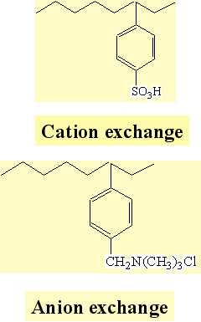
Process:
The hard water is passed first through Cation exchange column, which removes the cations like Ca²⁺ and Mg²⁺ etc from it, and equivalent amount of H⁺ ions are released from the column to water.
2RH + Ca⁺² → R₂Ca + 2H⁺
2RH + Mg⁺² → R₂Mg + 2H⁺
After Cation exchange column, the hard water is passed through anion exchange column, which removes all the anions like SO₄²⁻⁻, Cl ⁻, CO₂³⁻ etc. present in the water and equivalent amount of OH ions are replaced from this column to water.
ROH + Cl⁻ → RCl + OH⁻
2ROH + SO₄⁻² → R₂SO₄ + 2OH⁻
H+ and OH- ions (released from cation exchange and anion exchange columns respectively) get combined to produce water molecule.
H⁺ +OH⁻ → H₂O
OH

Slide 40
Regeneration :
Exhausted cation resin regenerated by dil. HCl , anion by dil.NaOH.
R₂Ca + 2 H⁺ → 2RH + Ca⁺² (washed)
R₂SO4 + 2OH⁻ → 2ROH⁻ + SO₄⁻²(washed)
Advantages:
The process can be used to soften highly acidic or alkaline waters;
It produces water of very low hardness, say 2ppm.
So it can be used in high pressure boilers.
Disadvantages:
The cost of equipment is relatively high and also more expensive chemicals (resins) are needed.
Fe, Mn – containing water and turbid water cannot be treated because Fe and Mn are irreversibly exchanged and turbidity reduces the efficiency of the process.

Slide 41
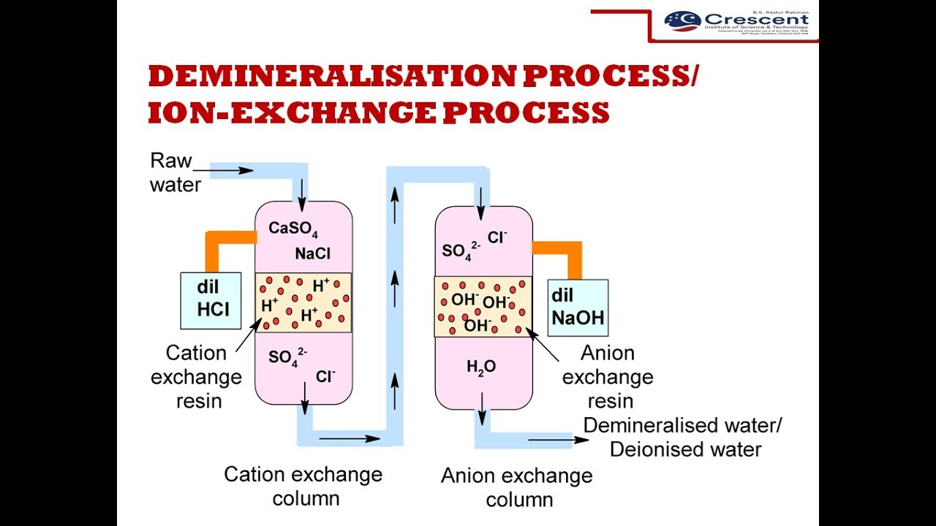

Slide 42
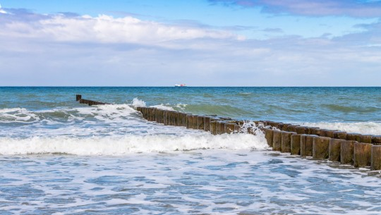
Desalination of brackish water
The process of removing common salt (sodium chloride) from water, is known as desalination.
The water containing dissolved salts with a peculiar salty (or brackish) taste, is called brackish water.
Sea water, containing on an average about 3.5% salts, comes under this category.
Brackish water is totally unfit for drinking purpose.
Commonly used methods for the desalination of brackish water is Reverse osmosis.

Slide 43
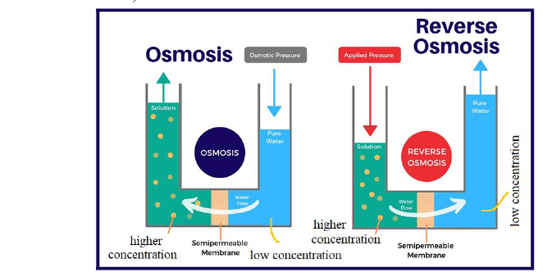
Reverse osmosis:
When two solutions of unequal concentrations are separated by a semi permeable membrane, flow of solvent takes place from dilute to concentrated sides, due to osmosis.
If, however, a hydrostatic pressure in excess of osmotic pressure is applied on the concentrated side, the solvent flow reverses.
That is solvent is forced to move from concentrated side to diluted side across the membrane. This is the principle of reverse osmosis.

Slide 44
Thus, in reverse osmosis method, pure solvent is separated from its contaminates, rather than removing contaminates from water.
This membrane filtration is sometimes also called super filtration or hyper-filtration
Advantages:
This process removes, ionic as well as non-ionic, colloidal and high molecular weight organic matter.
It removes colloidal silica, which is not removed by demineralization process.
The life time of membrane is quite high, about 2 years.
The membrane can be replaced within a few minutes, thereby providing nearly uninterrupted water supply.
Due to low cost, simplicity and high reliability, the reverse osmosis is gaining ground at present for converting sea water into drinking water.

Slide 45
Short answer questions
List types of impurities in water.
Compare soft water with hard water.
Define brackish water and distilled water.
Differentiate Scales from Sludges.
What is desalination?
Write a not on reverse osmosis.
Define break point chlorination.
List specifications of portable water.
Define caustic embrittlement.
Compare temporary hardness with permanent hardness.
Write principle in EDTA method.
Define disinfection and give examples.
What are coagulants and give examples.
List salts causing temporary and permanent hardness.

Slide 46
Long answer questions
What is hardness? Explain different types of hardness with units.
Elaborate ion exchange process with neat diagram and write limitations.
Explain various stages in the portable water treatment.
Describe the desalination of brackish water by Reverse Osmosis. Mention its advantages.
Illustrate caustic embrittlement.
Differentiate scales from sludges.
What is chlorination? Discuss break point chlorination.
Write a detailed notes scales and sludges.
Discuss internal water treatment.
Explain Defluoridation by Nalgonda Technique.

